Slide 1


Test Automation Using Selenium
Fair Hike Academy
That’s the way the cookie crumbles!
Session 11: Selenium WebDriver – Multiple Browsers
Mentor : Naresh Vulli, CSTE, PAHM.
fairhike@gmail.com www.fairhike.blogspot.com | www.facebook.com/fairhike

Slide 2
Today’s Topics
Recap
lib Folder
InternetExplorerDriver
IE Settings
GoogleSearch Program with IE Browser
ChromeDriver
GoogleSearch Program with Chrome Browser
Takeaways or Exercise

Slide 3
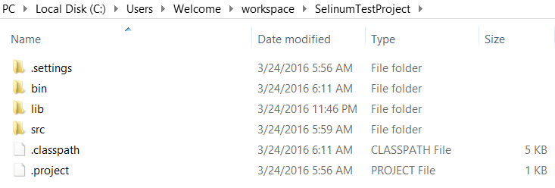
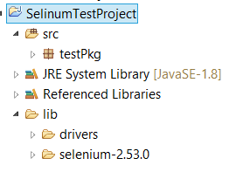
lib

Slide 4
InternetExplorerDriver
http://www.seleniumhq.org/download/
The Internet Explorer Driver Server – 2.35.0
Unzip the Exe
Copy to your Project folder under “lib/drivers” Folder

Slide 5
IE Settings
Zoom = 100%
Unexpected error launching Internet Explorer. Browser zoom level was set to 125%. It should be set to 100%
Tool → InternetOptions → Security → Protect Mode for different Timezones
Unexpected error launching Internet Explorer. Protected Mode settings are not the same for all zones. Enable Protected Mode must be set to the same value (enabled or disabled) for all zones

Slide 6
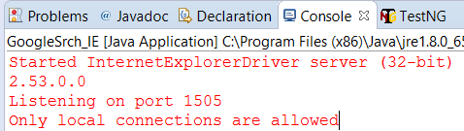
GoogleSearch Program with IE Browser
String java.lang.System.setProperty(String key, String value)
System.setProperty ( "webdriver.ie.driver", "./lib/drivers/IEDriverServer.exe");

Slide 7
ChromeDriver
https://sites.google.com/a/chromium.org/chromedriver/
ChromeDriver 2.21
Unzip the Exe
Copy to your Project folder under “lib/drivers” Folder

Slide 8
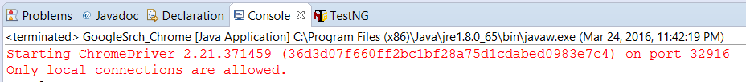
GoogleSearch Program with Chrome Browser
String java.lang.System.setProperty(String key, String value)
System.setProperty( "webdriver.chrome.driver", "./lib/drivers/chromedriver.exe“ );

Slide 9
Takeaway or Exercise
Execute Google search program with all three Browser IE, Chrome and Firefox

Slide 10
Q & A

Slide 11
Thank You ☺

